Slide 1
JUMP ROPE TUTS

Slide 2
ABOUT THE APP
An app which contains basic jump rope and workouts.With this app a person can do jump rope workouts and also learn them.

Slide 3
SCREENSHOTS

Slide 4
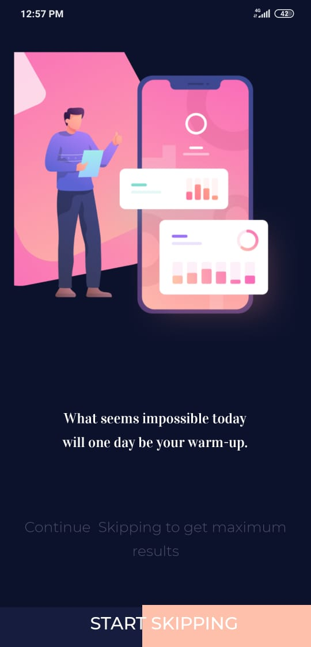
This is the main activity of the app.
When we touch the start skipping button,a google login page appears as shown in next slide.We used firebase google sign in for doing so.
This screen does not appear if the user is aldready logged in.
The documentation for implementing firebase google login is given in the link below:
https://firebase.google.com/docs/auth/android/google-signin

Slide 5
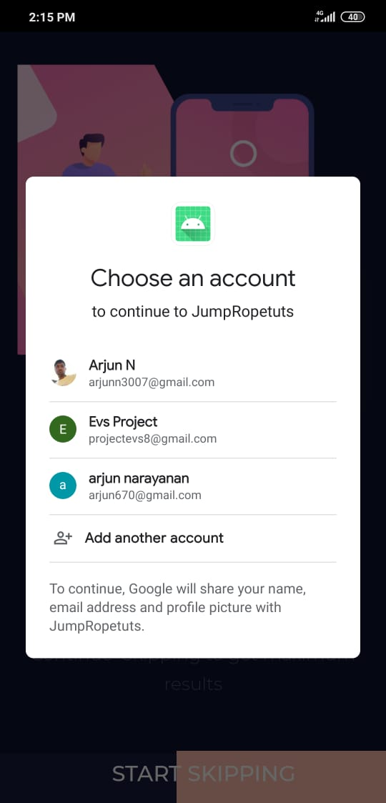
-We have to choose a google account.After selecting the google account.After selecting the we will be redirected to dashboard.

Slide 6
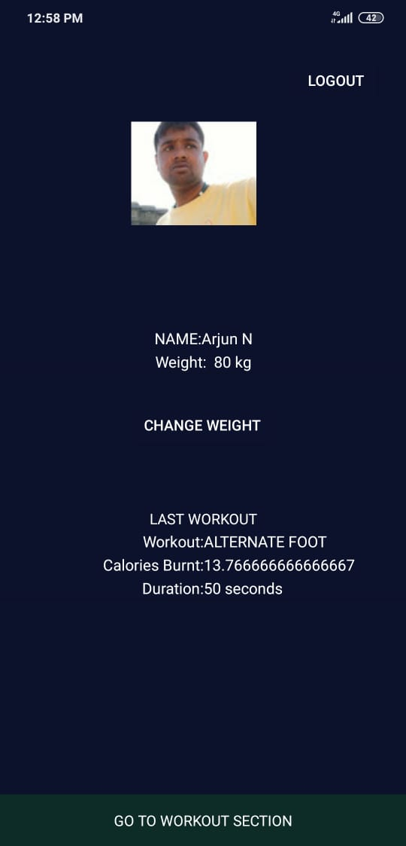
-This is the dashboard.In this,the basic information of the user is listed and also the information on the last workout is displayed.
-The bottommost button redirects the user to workout selection .
-The user can also change his/her weights using “CHANGE WEIGHT” button.When this button is clicked a dialog appears as shown in next slide.
-The profile picture is loaded from the users google acount.For setting the picture a 3 rd party library known as GLIDE is used.
The link for the library is given below:
https://github.com/bumptech/glide

Slide 7
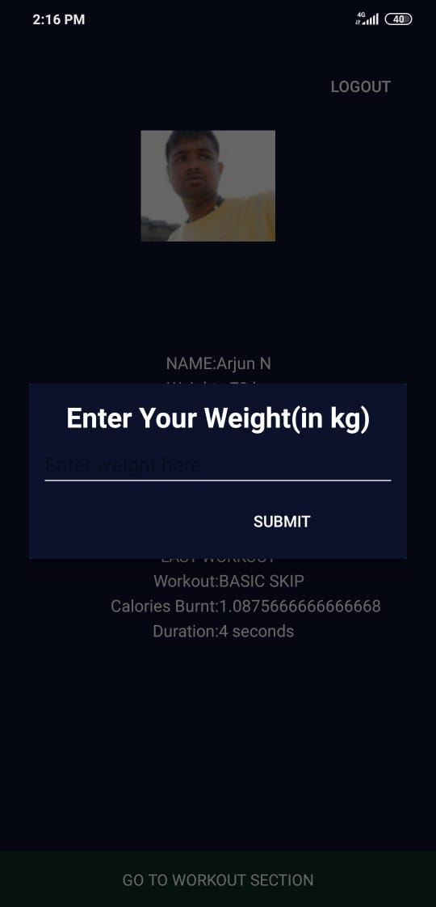
- This dialog pops up when We click change weight in the dashboard
- The user can enter his/her new weight.

Slide 8
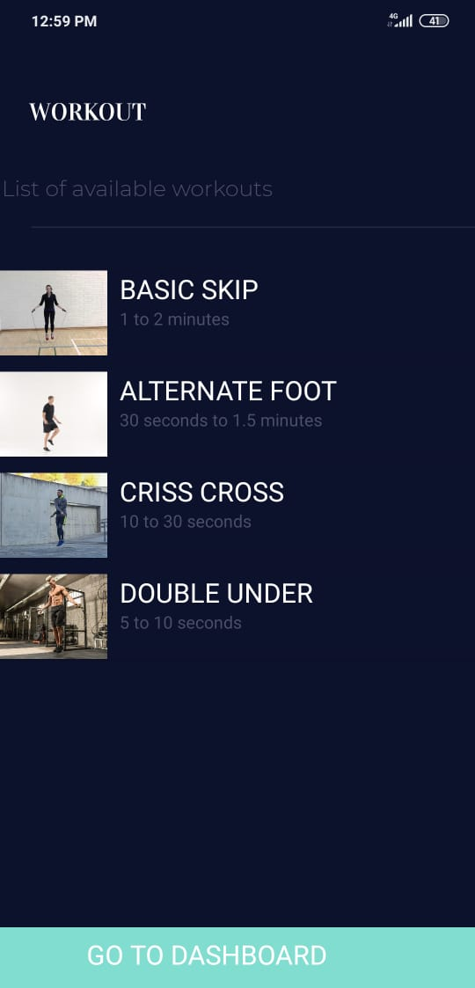
- The user can select any one workout from the list of 4 available workouts.
-For the list of workouts we used custom listview (Cardview is used to design the layout of the listview).
-After selecting the workouts the user is redirected to the startworkout activity.

Slide 9
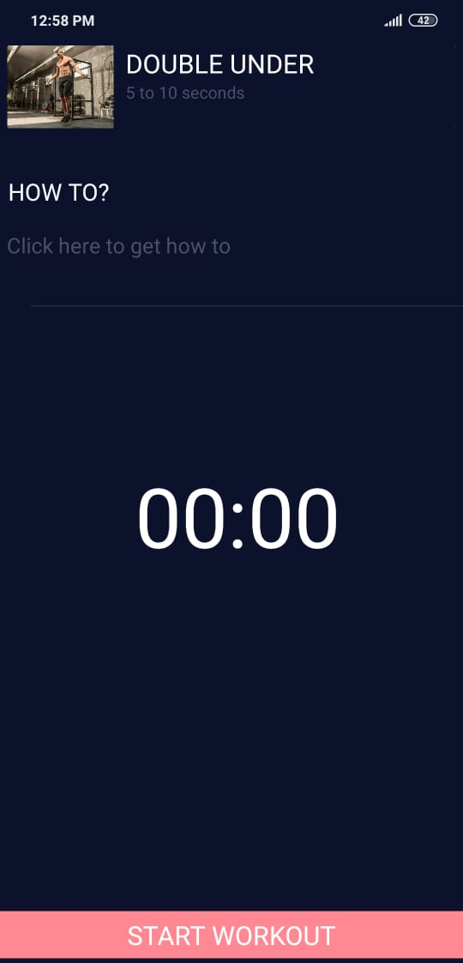
Here the user can click the textview containing ‘Click here to get how to”.This will open youtube app containing the link.Else click start workout.
Once the user clicks start workout a popup containing the asking for the time appears.

Slide 10
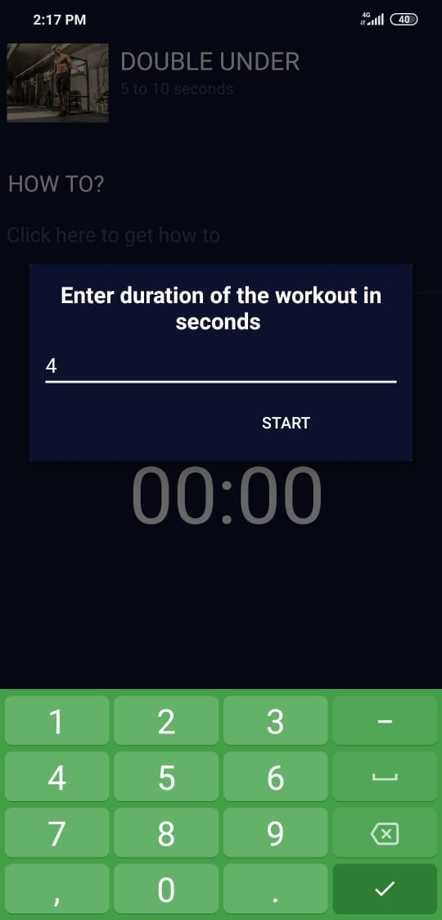
With this the user can set the time and start the workout.

Slide 11
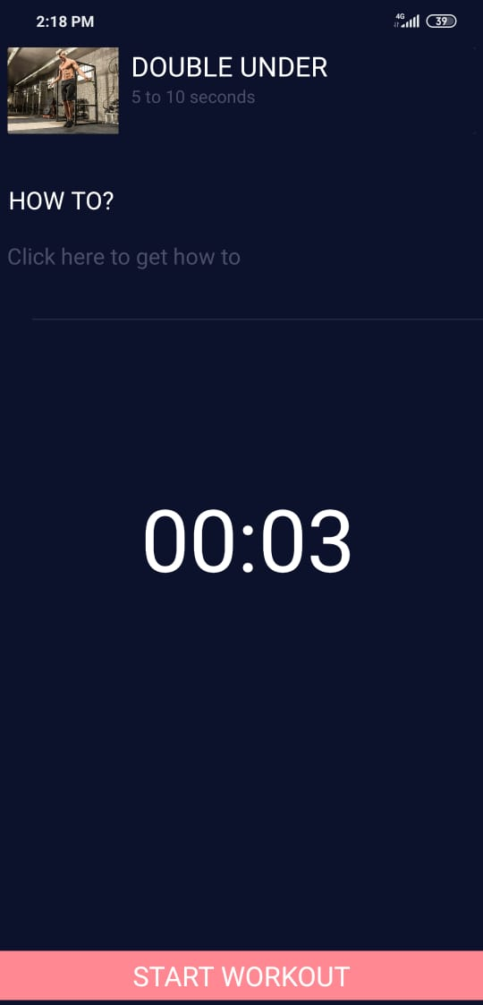

Slide 12
FUTURE PLANS
Improve UI
Add more workouts
The user will be able to customize workouts

